Slide 1
Computer Vision: Projective geometry
Umberto Castellani

Slide 2
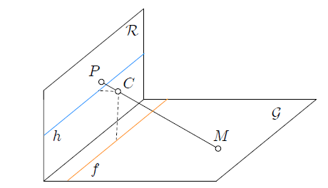
Perspective projection
Line on the space are trasformed into line on R
If we consider a plane G orthogonal to R, and its projection to R
The line f given by the intersection between the plane G and the plane parallel to R passing through C cannot be projected to R,
The line h (the intersection between R and a parallel plane to G passing through C) is not the projection of any line in G,

Slide 3
Perspective projection
This situation is not satisfying...
We need an «ideal line» called line at infinity, in this fashion f is the projection of the line at infinity of R, and h is the projection of the line at infinity of G.

Slide 4

Projective plane
A projective plane P² is the join beween the affine plane A² and the line at infinity l∞
in a projective plane two lines have an intersection also for parallel lines → this point is at infinity,
every line contains a infinity point that can be reached going through the direction of the line,
the points at infinity can be considered as the absolute directions of lines,

Slide 5
Projective geometry
To deal with geometric objec we use tools from linear algebra:
geometric entities are described in terms of coordinates and algebraic entities, e.g., a point is identified with a vector in terms of some coordinate basis.
algebraic approach to geometry is that results derived in this way may more easily be used to derive algorithms and practical computational methods.
We need to consider the distinction between “column” and “row” vectors, since a matrix may be multiplied on the right by a column and on the left by a row vector.
Geometric entities will by default be represented by column vectors.

Slide 6





Lines
A line in the plane is represented by the equation:
This line can be represented by the vector ,
Different choice of a, b, and c give rise to different lines,
The correspondence betwen the line and the vector is not one-to-one
Same line

Slide 7



Lines
Vectors and represent the same line
Two such vectors related by an overall scaling are considered as being equivalent,
An equivalence class of vectors under this equivalence relationship is known as an homogeneous vector,
Any particular vector is a representative of the equivalence class.
The set of equivalence classes of vectors in forms the projective space

Slide 8


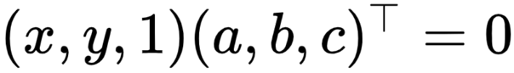
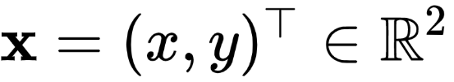


Points
A point lies on the line if and only if
This can be written by the inner product:
the point is represented as a 3-vector by adding a final coordinate of 1.
and line , if and only if

Slide 9
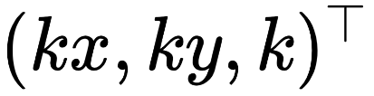

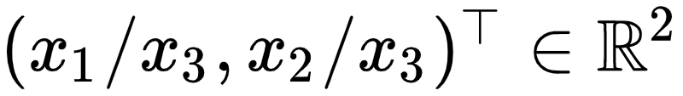
Points
The set of vectors , for varying values of k are the representation of the vector
As with lines, points are represented by homogeneous vectors.
An arbitrary homogeneous vector representative of a point is of the form , representing the point
Points, as homogeneous vectors, are also elements of

Slide 10


Homogeneous coordinates
Points and lines are represented in the projective space by homogeneous coordinates
Homogeneous coordinates
Inhomogeneous coordinates
Often ihhomogeneous (or Euclidean) coordinates are represented by
3-vector
2-vector
It is possible to move from homogeneous (or projective) coordinates in the projective space to inhomogeneous (or Euclidean) coordinate in the Euclidean space (and viceversa)
How?

Slide 11




Homogeneous coordinates
For 3D entities we can define the projective space from the 3D Euclidean space
Homogeneous coordinates
Inhomogeneous coordinates
4-vector
3-vector
It is possible to move from homogeneous (or projective) coordinates in the projective space to inhomogeneous (or Euclidean) coordinate in the Euclidean space (and viceversa)
How?

Slide 12

Points and lines
We have obtained the following:
inner product
The point x lies on the line l if and only if
The simplicity of this expression is the direct consequence of the use of homogeneous vectors representation of lines and points.

Slide 13


Intersection of lines
Given two lines and
cross product
The intersection between l and l’ is the point
The simplicity of this expression is the direct consequence of the use of homogeneous vectors representation of lines and points.
See notes!

Slide 14


Lines joining points
Given two points and
The line through two points x and x’ is
Again, the simplicity of this expression is the direct consequence of the use of homogeneous vectors representation of lines and points.
See notes!

Slide 15




Intersection of parallel lines
Given two lines and
... represented by vectors and
The intersection is the point
See notes!

Slide 16
Intersection of parallel lines
Given two lines and
... represented by vectors and
The intersection is the point
What is the inhomogeneous representation of this point?

Slide 17


Intersection of parallel lines
Given two lines and
... represented by vectors and
The intersection is the point
What is the inhomogeneous representation of this point?
Points with homogeneous coordinates do not correspond to any finite point in

Slide 18
Exercise
Find the itersection ot the two lines of equations x=1 and x=2.
y
1
2
x
See notes!

Slide 19



Ideal points
Homogeneous vectors with correspond to finite points in
The Euclidean space can be augmented by adding points with last coordinate
The resulting space is the Projective space
Points with last coordinates are called ideal points or points at infinity

Slide 20




Line at infinity
The set of all ideal points can be written
This set lies on a single line, the line at infinity
This line is denote by
Note:

Slide 21


Line at infinity
A line intersects in
A line parallel to l intersects in regardless of the value c’
Verify!
Verify!

Slide 22

Line at infinity
Note: in inhomogeneous coordinates is a vector tangent to the line l and orthogonal to the line normal (a,b), and so represents the line’s direction
As the line’s directions varies the ideal point varies over
The line at infinity can be thought of as the set of directions of lines in the plane

Slide 23
Intersection of points and lines
In the projective plane , one may state without quantification that:
This is not true in the standard Euclidean spece where parallel lines form a special case.
«two distinct lines meet in a single point and two distint points lie on a single line»

Slide 24
Projective geometry
The study of the geometry of is known as projective geometry.
In the projective space there is no distinction between points at infinity (ideal points) and ordinary points

Slide 25
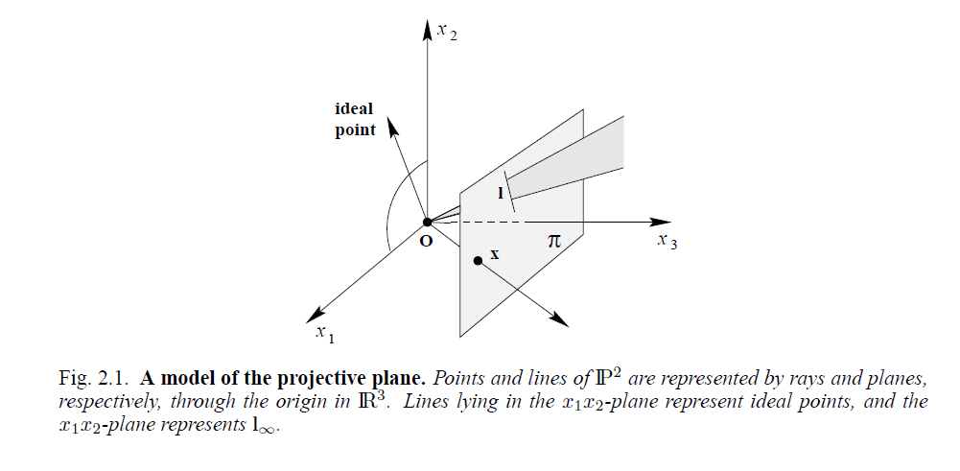
The projective plane
Image Credits: Hartley Zisserman book, pag. 29

Slide 26
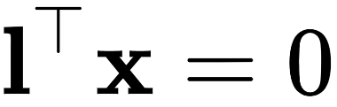
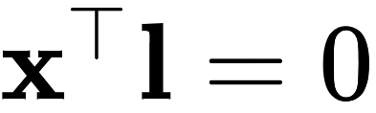
Duality
The role of lines and points are interchanged in statements concerning the properties of points and lines, in particular:
Intersection of two line and line through two points are essentially the same, with the roles of points and lines swapped.

Slide 27
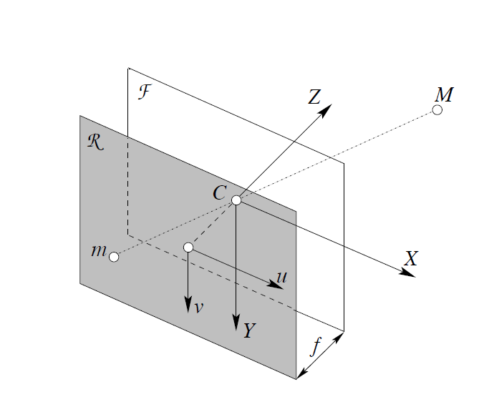
Pinhole camera
Image Credits: Andrea Fusiello

Slide 28
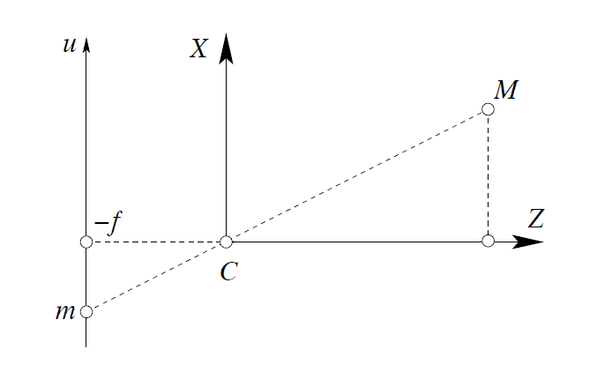
Pinhole camera
Image Credits: Andrea Fusiello

Slide 29
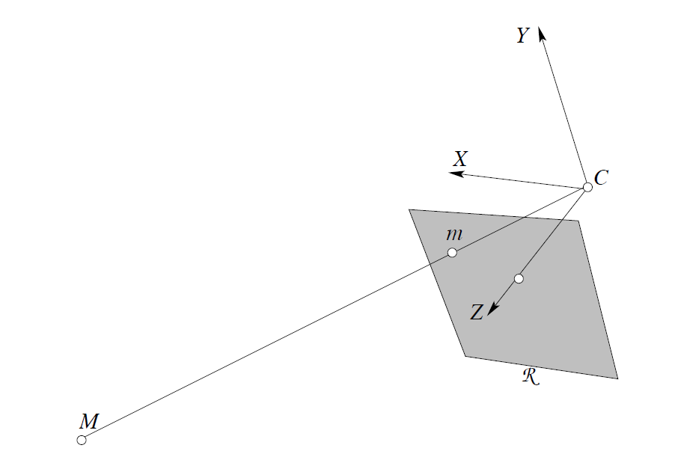
Pinhole camera
Image Credits: Andrea Fusiello

Slide 30
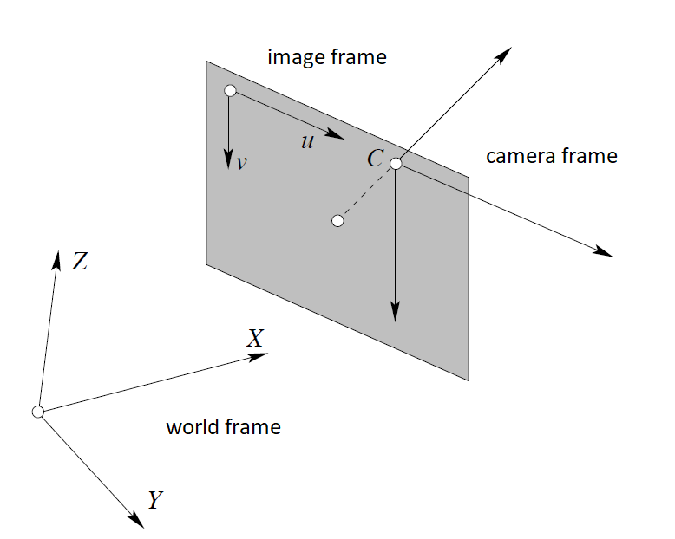
Pinhole camera
Image Credits: Andrea Fusiello

Slide 31
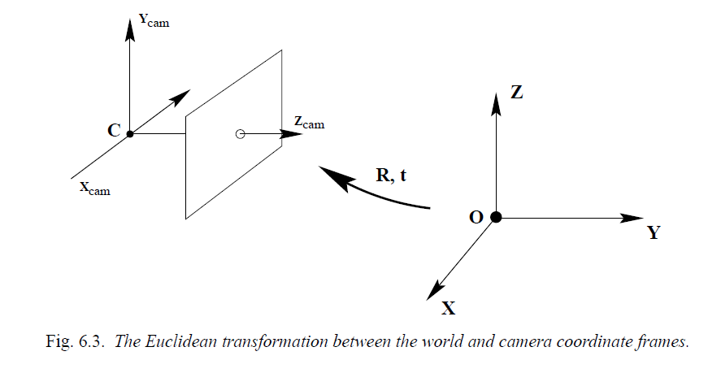
Pinhole camera
Image Credits: Hartley Zisserman book, pag. 156

Slide 32
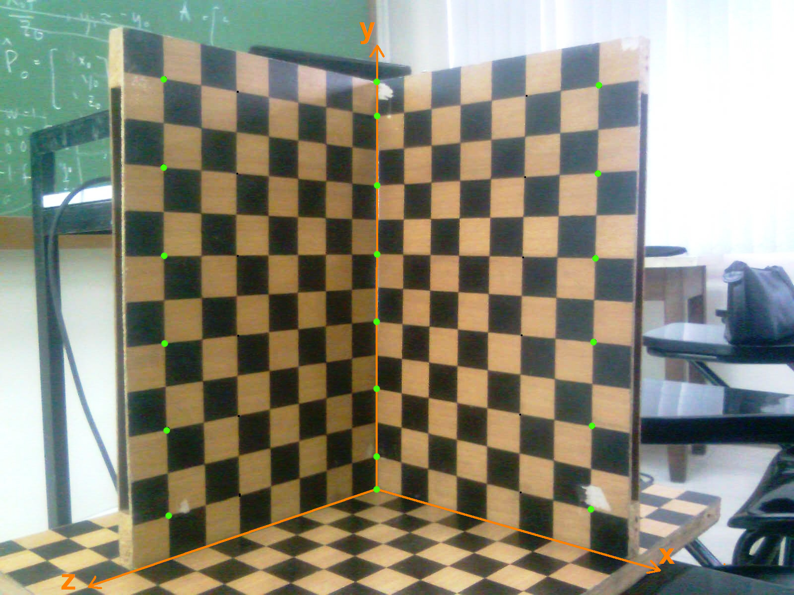
Calibration object

Slide 33
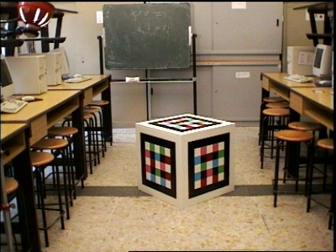
Calibration object

Slide 34
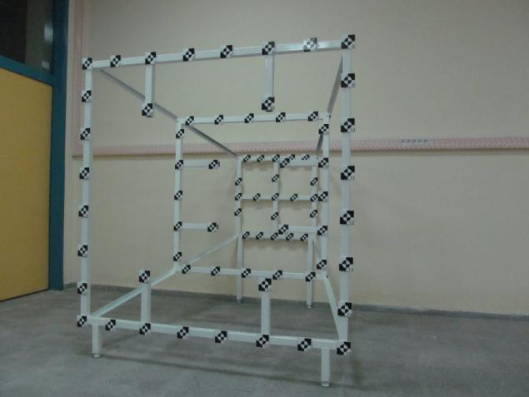
Calibration object

Slide 35
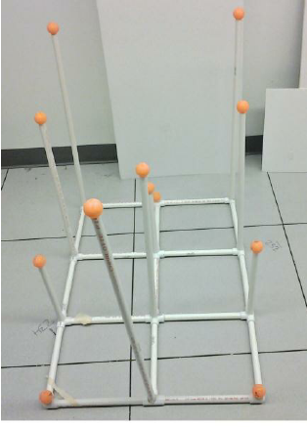
Calibration object

Slide 36
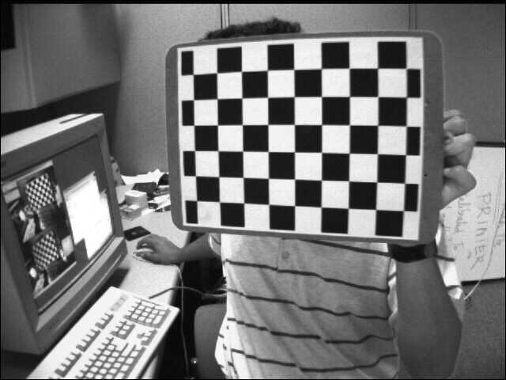
Calibration object

Slide 37
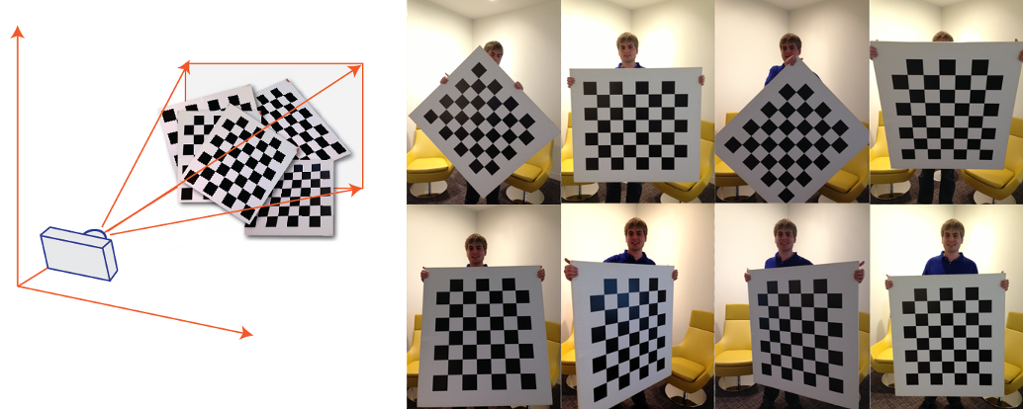
Calibration object

Slide 38
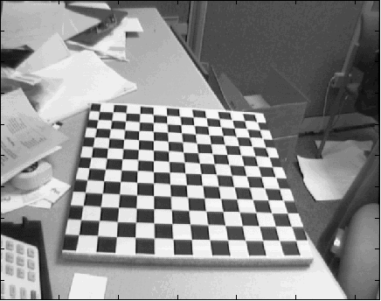
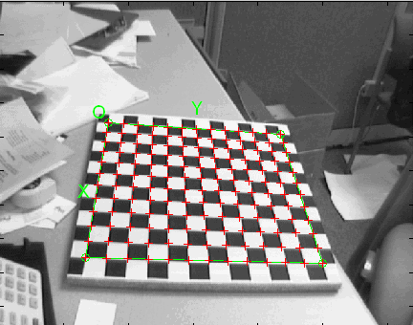
Calibration object

